Slide 1
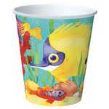
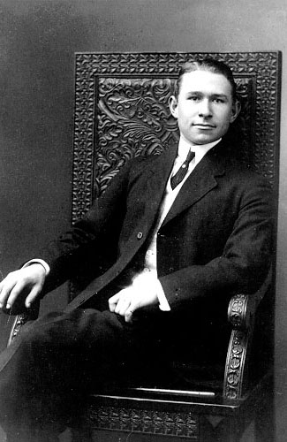
Amazing Little Dixie Cup
Five facts about this invention:
The Dixie Cup was invented to stop spreading germs.
The first name of the Dixie Cup was the Health Cup.
Dixie Cups were manufactured in Easton, Pennsylvania.
Dixie Cups are made of paper and are disposable.
Dixie Cup was the beginning of disposable kitchen products.
The Dixie Cup was invented in 1907.
It was invented by Lawrence Luellen and Hugh Moore.
Three facts about the inventors:
There were two inventors: Hugh Moore and Lawrence Luellen. Luellen had the idea and Moore had the money and marketing ability.
They created the first semi-automatic machine to manufacture the cups.
Both of the inventors were from Boston, Massachussetts.

